Slide 1
vGATE for CapeSym
Bill Worstell
PicoRad Imaging
1/1/2022

Slide 2
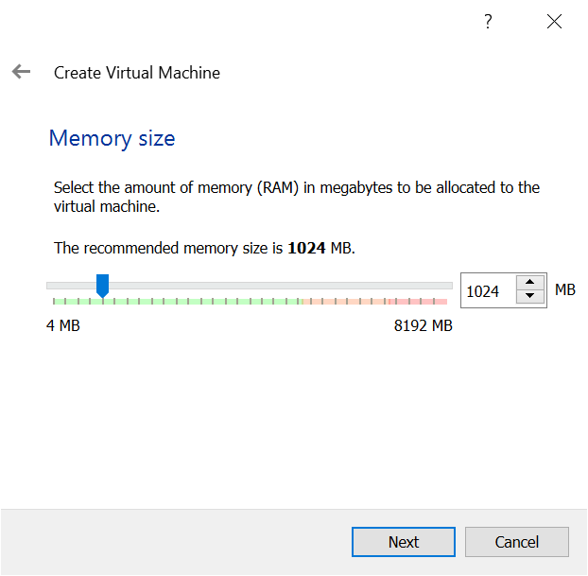
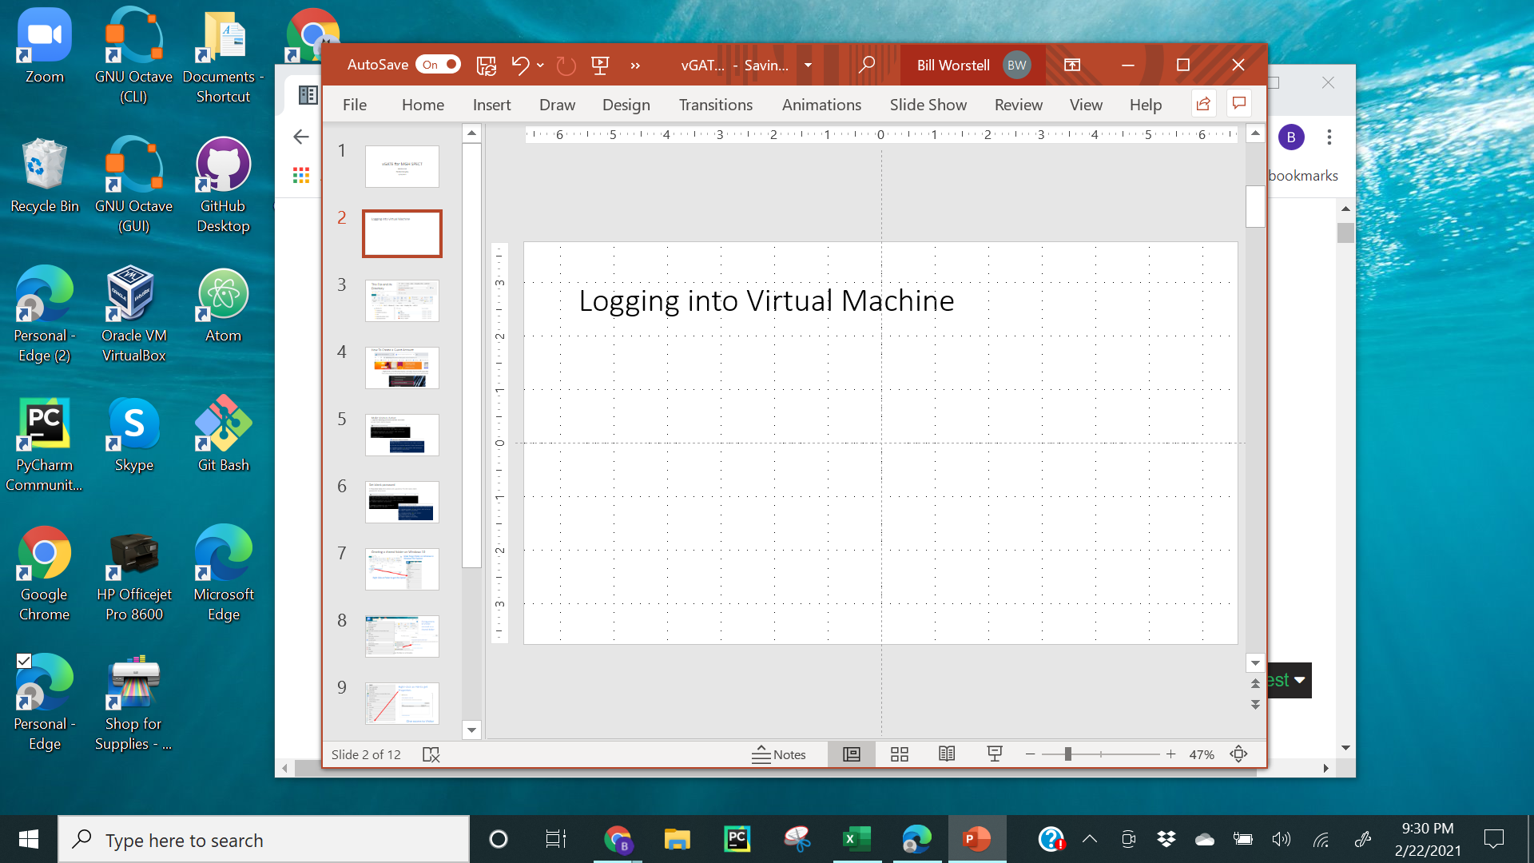
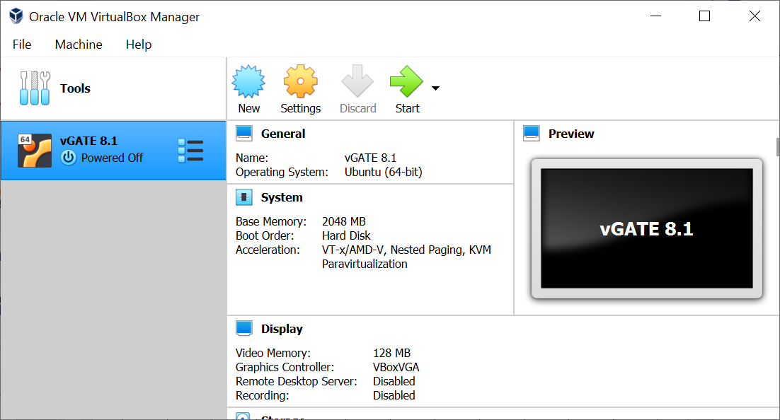
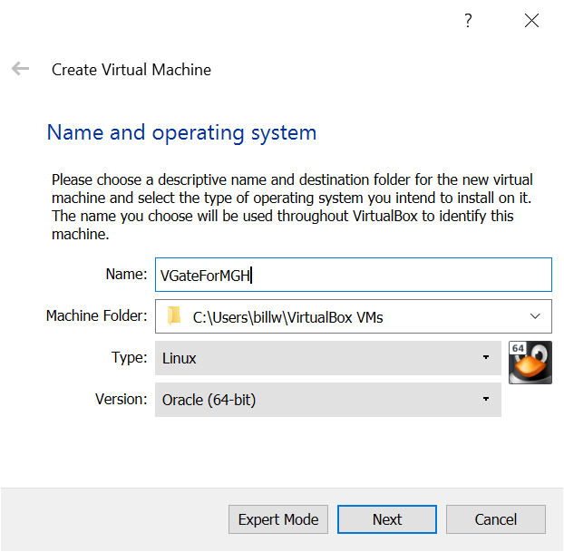
Logging into Virtual Machine
Click to
Create a New
Virtual Machine
Launch
Oracle VM
VirtualBox
Application

Slide 3
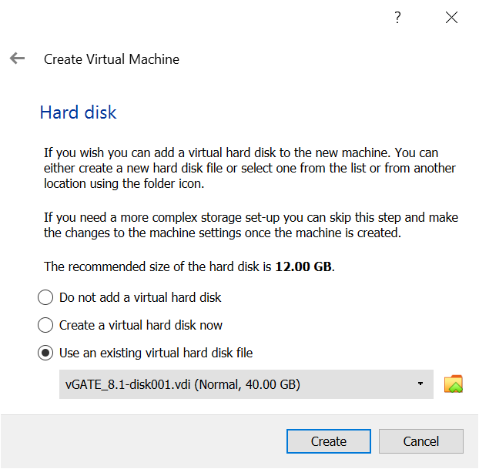
Creating Virtual Machine
Default
Memory
Size
Use Existing
Hard Disk

Slide 4
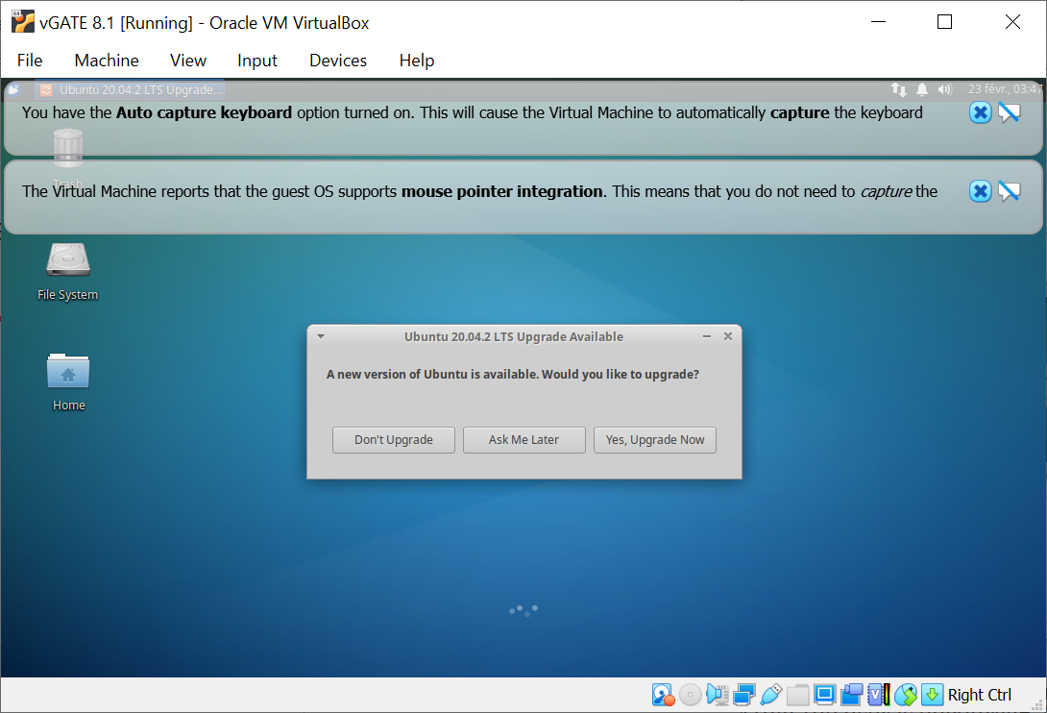
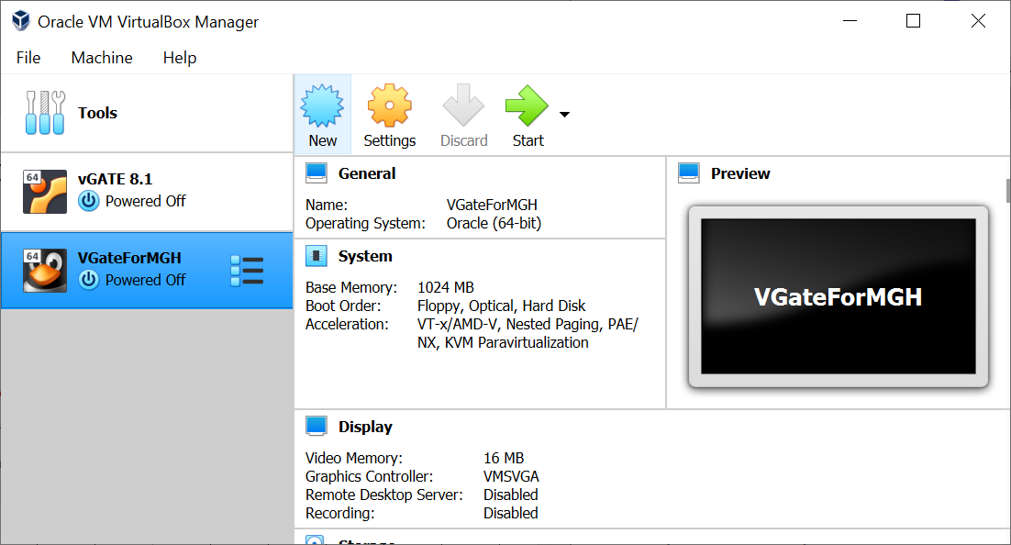
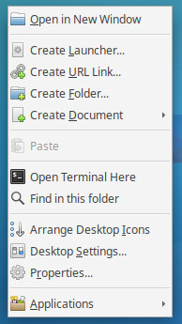
Go Back to the one I already had:
Don’t
update
the
Ubuntu
because
ghis vGATE works
Right click to get this menu

Slide 5
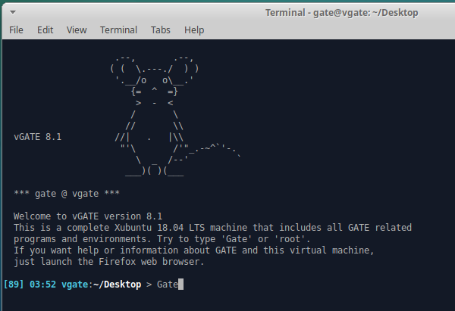
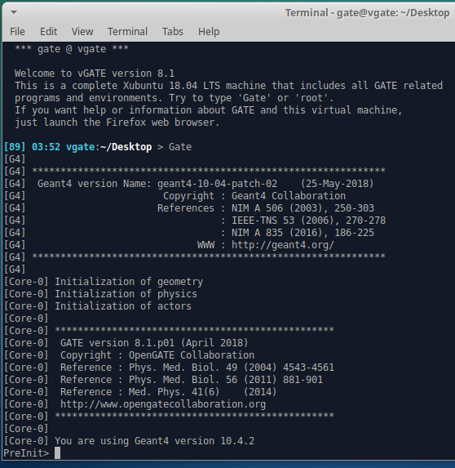
Open vGATE terminal and launch GATE

Slide 6
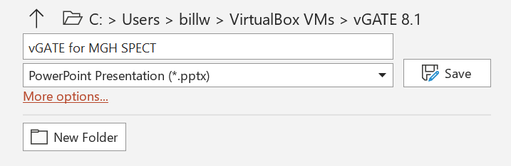
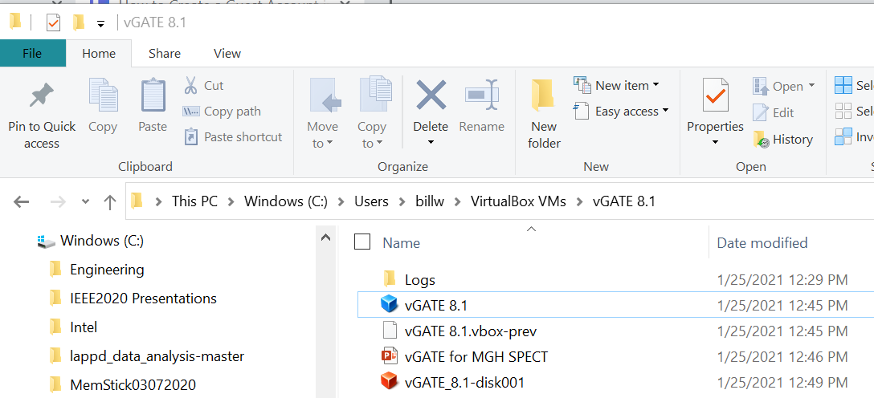
This File and its Directory

Slide 7
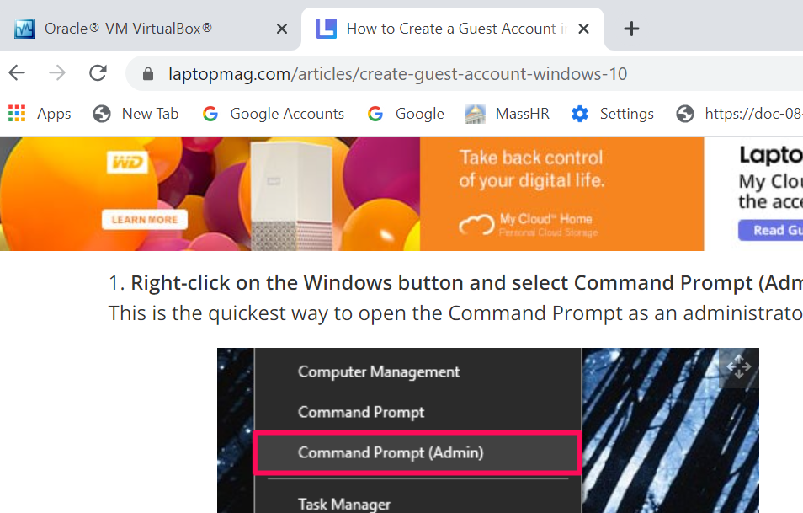
How To Create a Guest Account

Slide 8
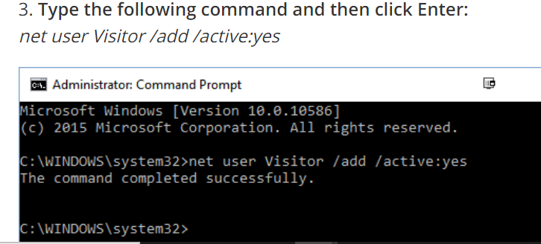
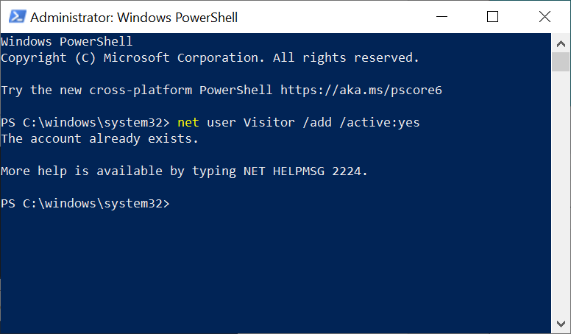
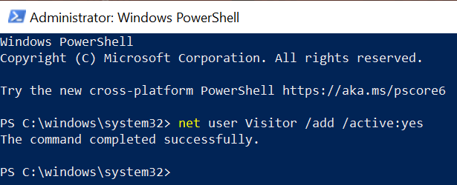
Make Visitors Active
Visitor Active State is Persistent

Slide 9
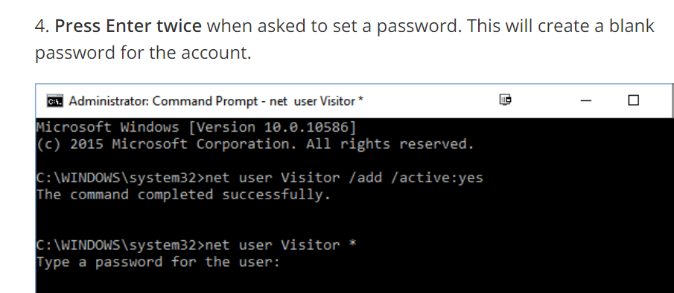
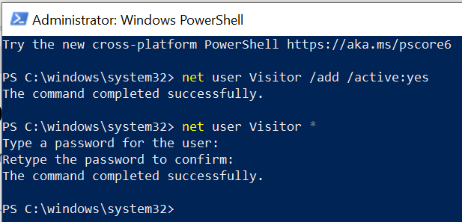
Set blank password

Slide 10
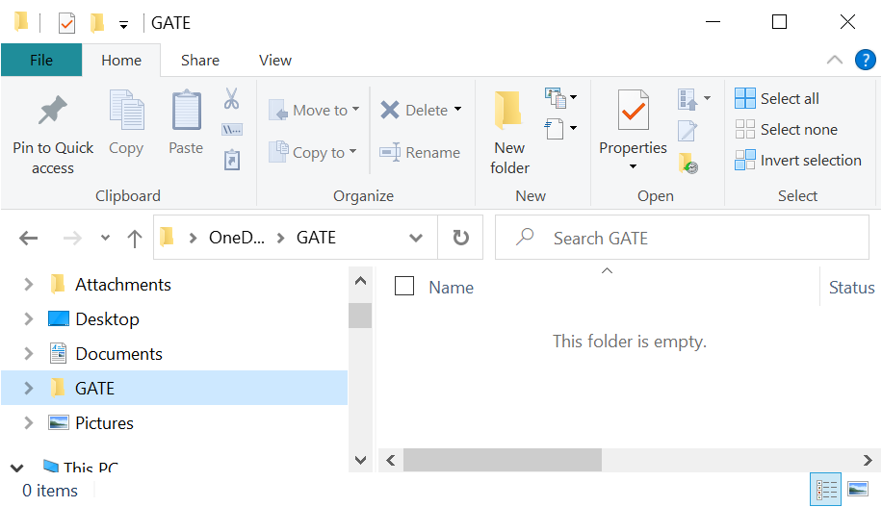
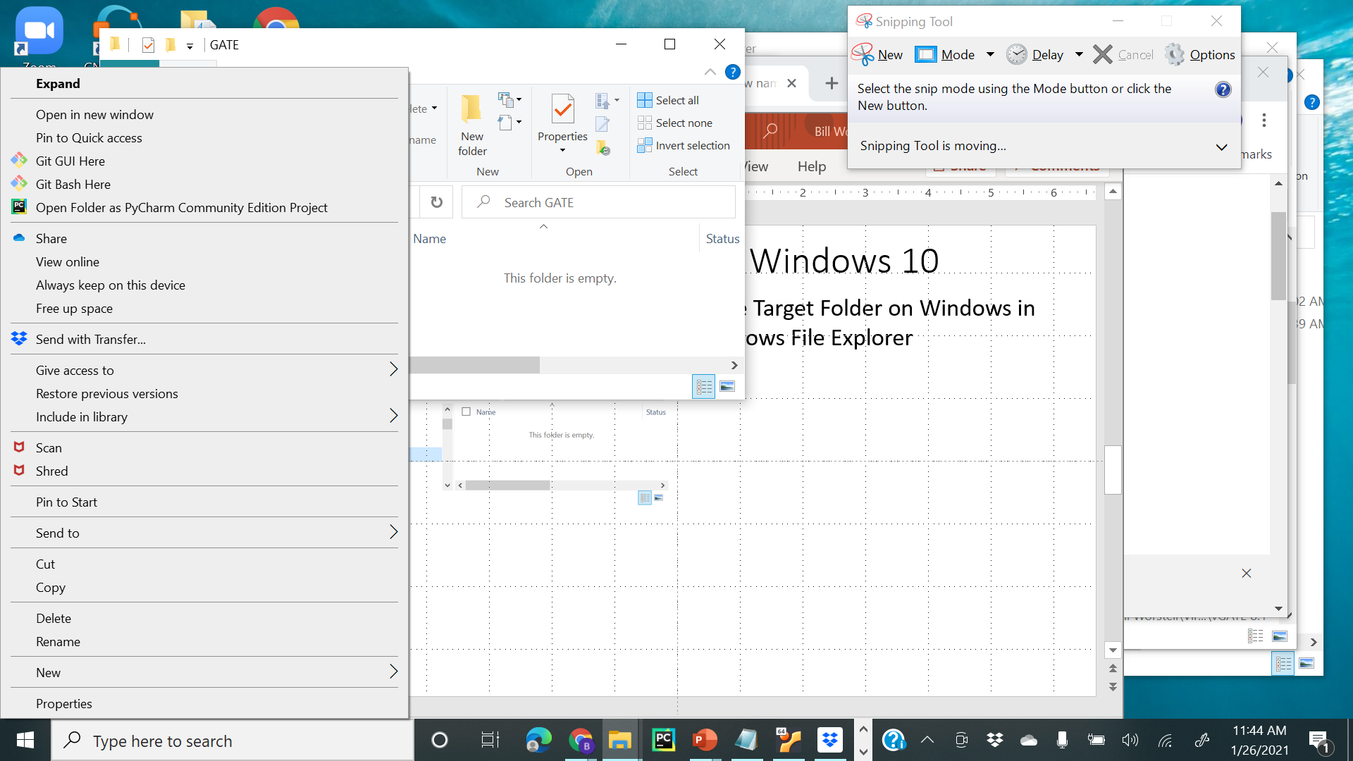
Creating a shared folder on Windows 10
Make Target Folder on Windows in
Windows File Explorer
Right Click on Folder to get this Option

Slide 11
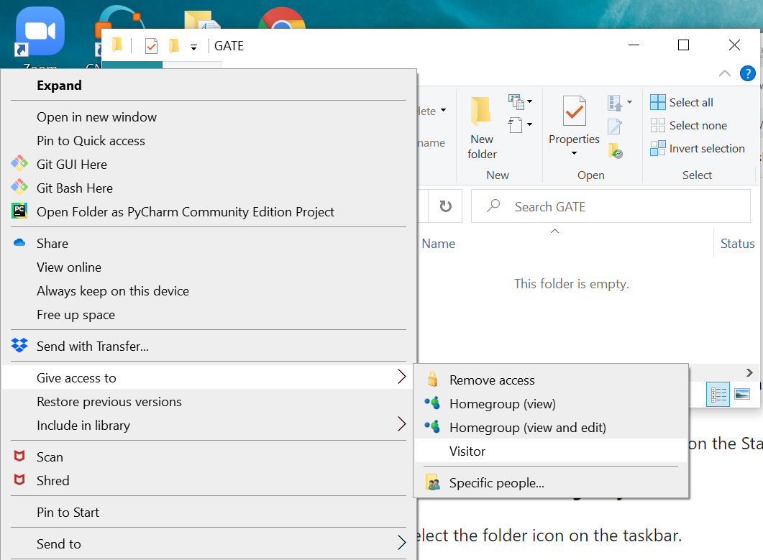
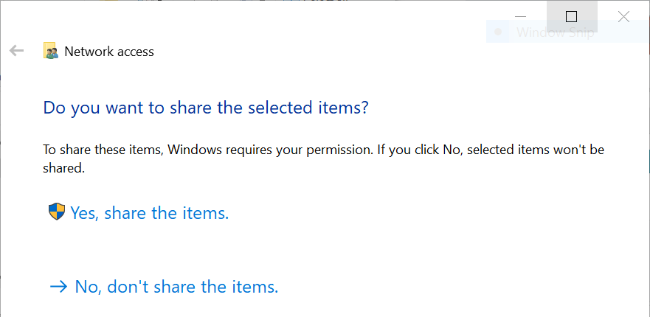
Giving access to Visitor account as a shared folder

Slide 12
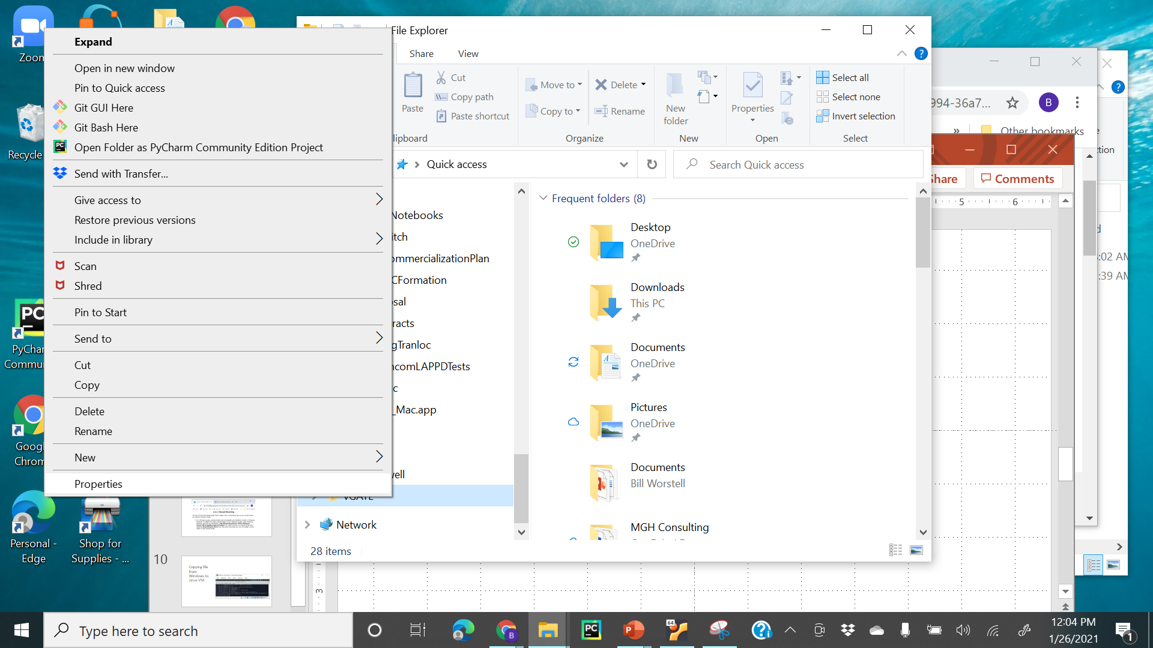
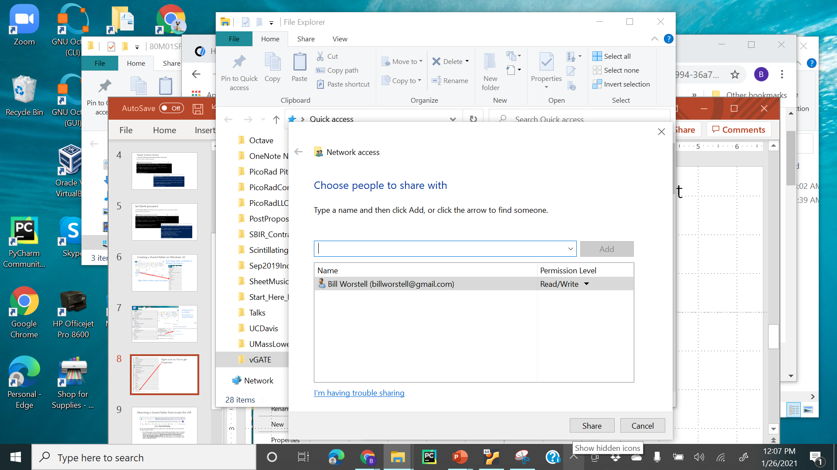
Right-click on File to get Properties
Give access to Visitor

Slide 13
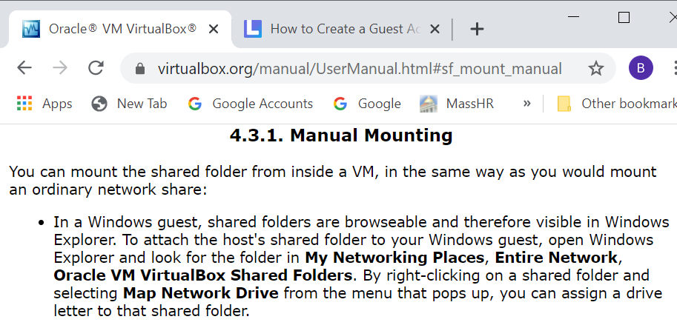
Mounting a shared folder from inside the VM

Slide 14
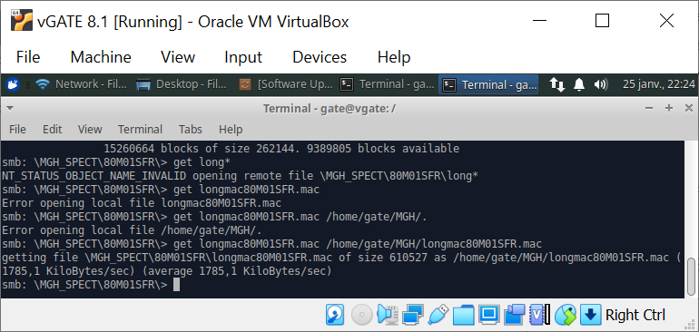
Copying file from Windows to Linux VM

Slide 15
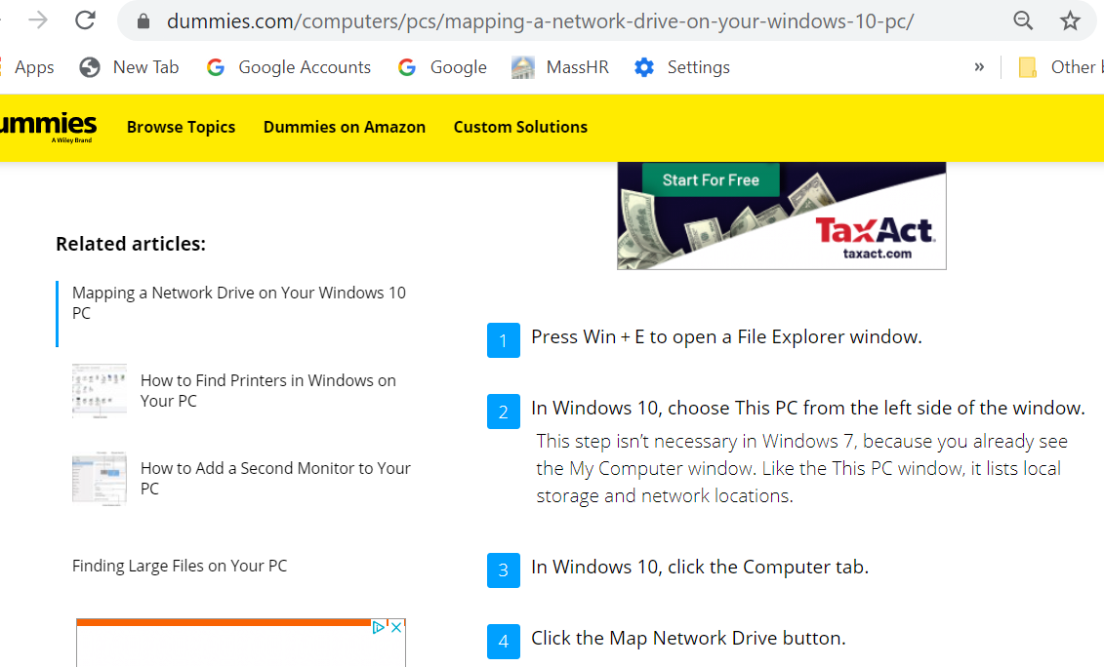
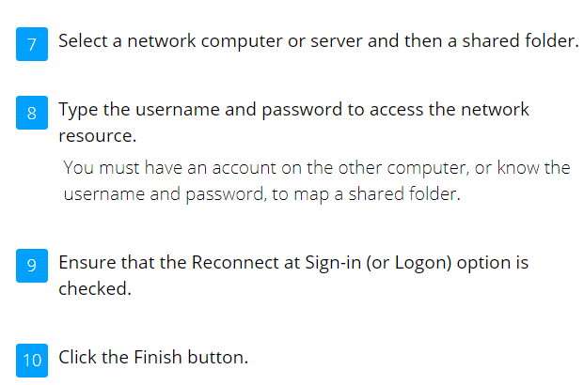
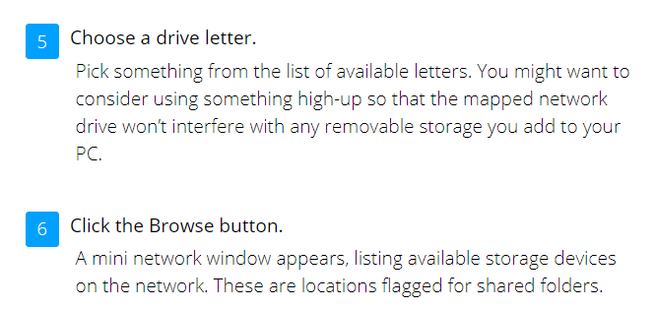
Mounting a network share from Windows 10

Slide 16
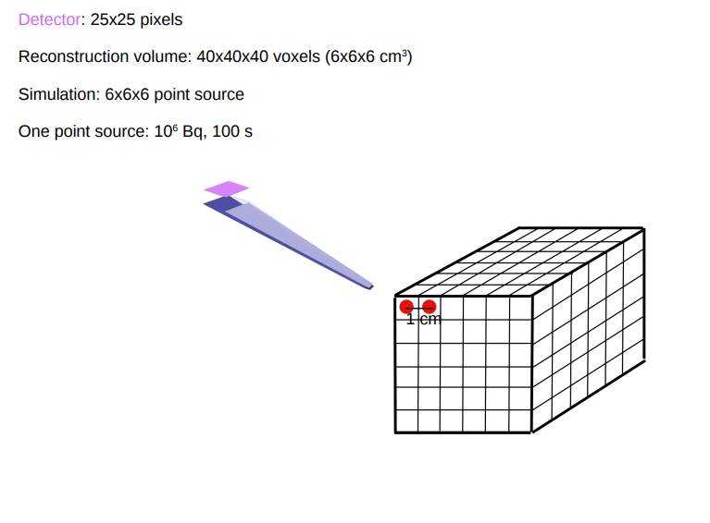
Yumeng: SimulationSystem.pdf Slide 1:

Slide 17
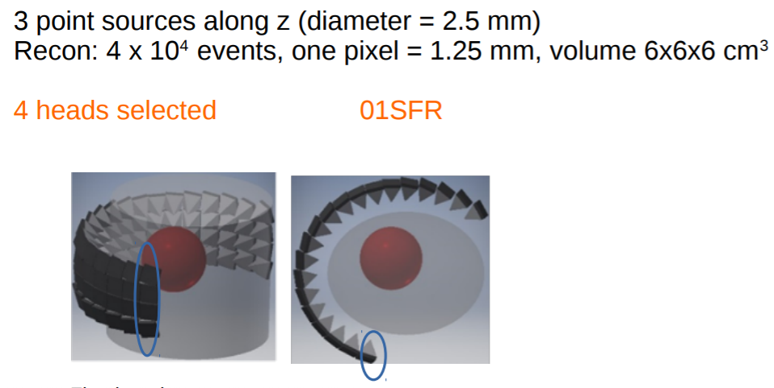
Yumeng: SimulationSystem.pdf Slide 23:

Slide 18
C:\Users\billw\Dropbox\Bill Worstell\Geometry variations\80M01SFR\excel80M01SFR
source_isocenter_distance = 243
source_detector_distance = 600

Slide 19
2D Circular orbit with 40 views:
Conventional Cone-beam CT

Slide 20
2D Circular orbit with 40 views:
Conventional Cone-beam CT

Slide 21
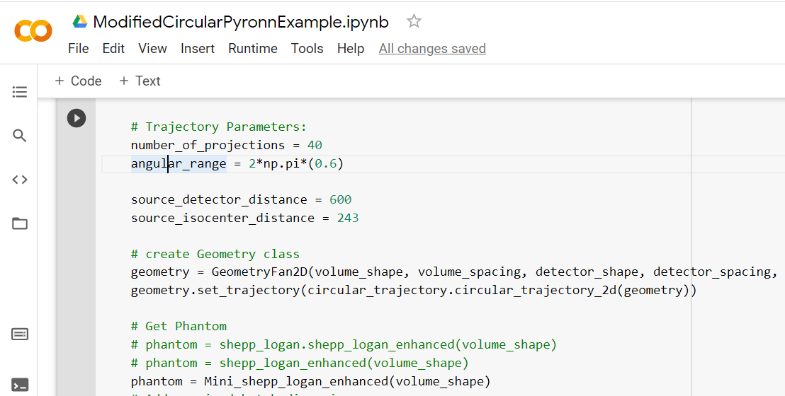
Running FBP reconstruction in PyroNN

